Slide 1
OS Virtualization

Slide 2
Outline
Background
What is Virtualization?
Why would we want it?
Why is it hard?
How do we do it?
Choices

Slide 3
What is Virtualization?
OS virtualization
  Create a platform that emulates a hardware platform and allow multiple instances of an OS to use that platform, as though they have full and exclusive access to the underlying hardware

Slide 4
What is Virtualization?
Applications
Applications
Applications
Applications
OS 1
OS 2
OS 3
OS 4
Virtualization Platform
Hardware

Slide 5
The Problem
OS uses kernel mode / user mode to protect the OS.
  System calls (privileged instructions) generate a trap (software interrupt) that forces a switch to kernel mode
  These calls trigger sensitive instructions (I/O, MMU control, etc.) that must only be executed by the kernel

Slide 6
The Problem
If our VM now runs in user space, we cannot run sensitive instructions in it, since those must trap to kernel space.
Solved in 2005 with new CPUs
  Intel Core 2 – VT (Virtualization Technology)
  AMD Pacific – SVM (Secure Virtual Machine)
  Provides new instructions that allow VM to capture traps

Slide 7
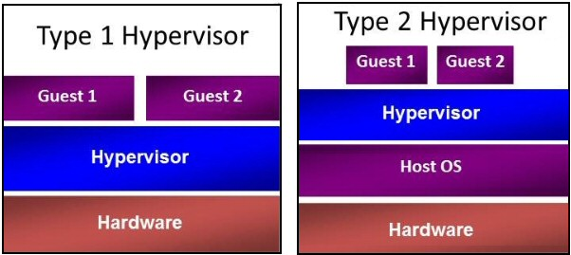
Implementation
Type 1 Hypervisor
Type 2 Hypervisor
Paravirtualization

Slide 8
Type 1 Hypervisor
Runs on “bare metal”
Virtual machines run in user mode
  VM runs the guest OS (which thinks it is running in kernel mode) – Virtual kernel Mode
  If guest OS calls sensitive instructions, hypervisor will trap and execute the instructions.
  If application on guest OS calls sensitive instructions (system calls), hypervisor traps to guest OS.

Slide 9
Type 2 Hypervisor
Runs from within a OS.
Supports guest OSs above it.
  Boot from CD to load new OS
  Read in code, looking for basic blocks
  Then inspect basic block to find sensitive instructions. If found, replace with VM call (process called binary translation)
  Then, cache block and execute.
  Eventually all basic blocks will be modified and cached, and will run at near native speed.
Notes:
cs431-cotter

Slide 10
Paravirtualization
Modify Guest OS so that all calls to sensitive instructions are changed to hypervisor calls.
Much easier (and more efficient) to modify source code than to emulate hardware instructions (as in binary translation).

Slide 11
Problems with Paravirtualization
Paravirtualized systems won’t run on native hardware
There are many different paravirtualization systems that use different commands, etc.
  VMware, Xen, etc.
Proposed solution:
  Modify the OS kernel so that it calls a special set of procedures to execute sensitive instructions (Virtual Machine Interface )
    Bare metal – link to library that implement code
    On VM – link to VM specific library

Slide 12
Memory Virtualization
OS tracks mapping of virtual memory pages to physical memory pages.
Builds page tables, then update paging register (trap).
Allow hypervisor to manage page mapping, and use shadow page tables for the VMs

Slide 13
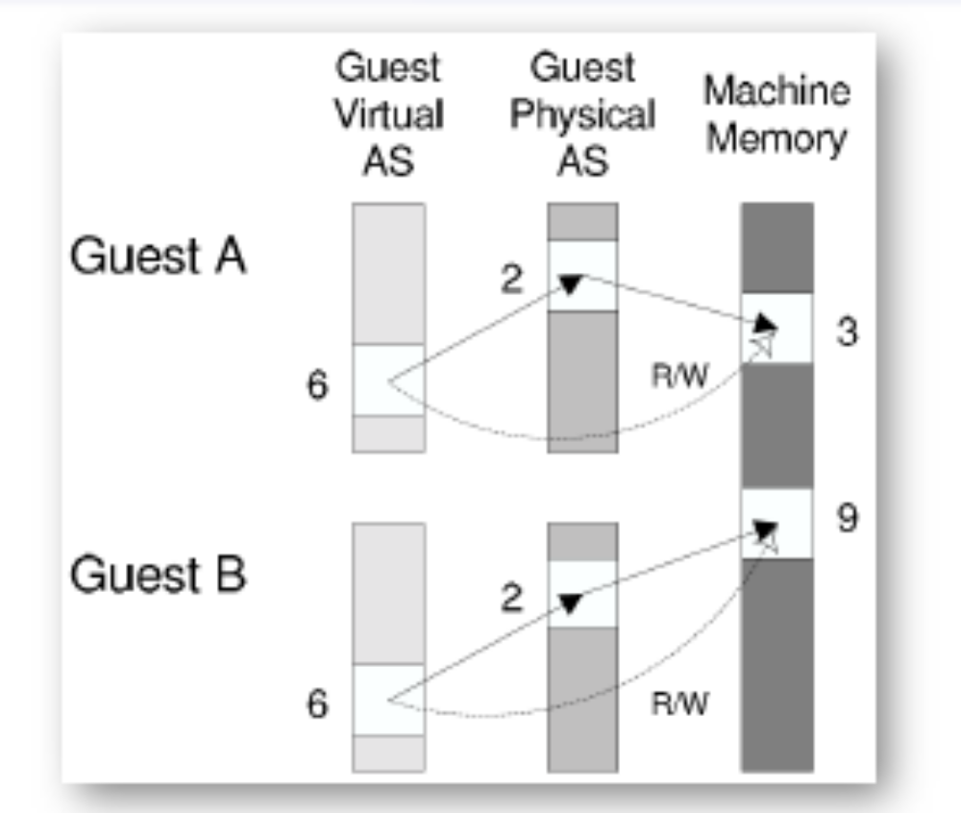
Shadow Page Table

Slide 14
I/O Virtualization
Each guest OS holds its own “partition”.
  Typically implemented as a file or region on disk
  Hypervisor must convert guest OS address (block #) into physical address in region
  May convert between storage types.
  Must deal with DMA requests

